Slide 1
GUVI CAPSTONE PROJECT CRAFTING COMPELLING WEB PRESENCES A DEXAVARY AGNES MBM6

Slide 2


DEUTSCHE BANK

Slide 3
AGENDA
Products of Deutsche Bank
Platform on which website has been developed
Testing the website
Website design mistakes to be avoided
Creating visually appealing and user-friendly website design
Landing page of Deutsche Bank

Slide 4


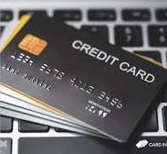


DEUTSCHE BANK PRODUCTS

Slide 5

In a Fixed Deposit, you put a lump sum in your bank for a fixed tenure at an agreed rate of interest. At the end of the tenure, you receive the amount you have invested plus compound interest until the given maturity date.

Slide 6


CREDIT CARD
A credit card is a physical payment card that allows you to get credit from a financial institution. You can use the pre-approved limit to make purchases and repay the borrowed amount with an interest each month within your billing cycle.

Slide 7
A loan is money borrowed from a bank or other financial institution. The borrower agrees to repay the principal amount, plus interest. Loans may be secured or unsecured, and they may be open-ended or closed-ended.

Slide 8

INVESTMENT
A mutual fund is a pool of money managed by a professional Fund Manager. It is a trust that collects money from a number of investors who share a common investment objective and invests the same in equities, bonds, money market instruments and/or other securities.

Slide 9
FOREX TRADING
Foreign exchange, or forex, traders speculate on changing exchange rates by converting large sums of money from currency to currency, much like stock traders buy and sell different stocks. Forex traders essentially attempt to buy low and sell high for a profit, but the asset they are trading is currency.

Slide 10
Platform on which website has been developed
TOOL WAPPALYZER

Slide 11
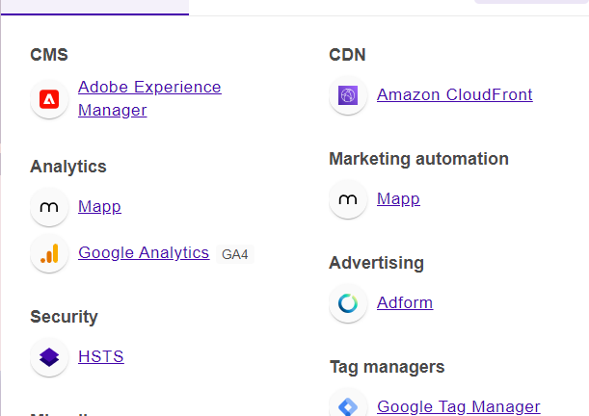
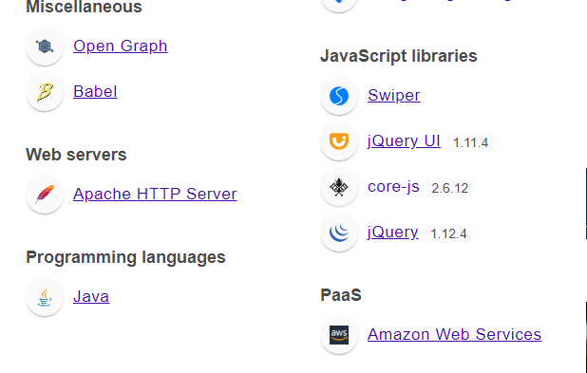

Slide 12
TESTING THE WEBSITE
PHONE VIEW
TABLET VIEW
LAPTOP VIEW
DESKTOP VIEW

Slide 13
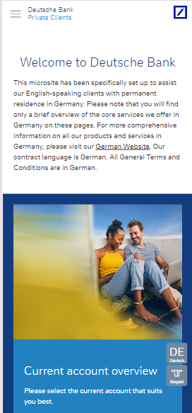
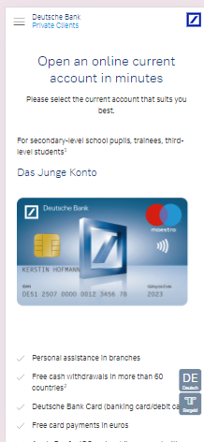
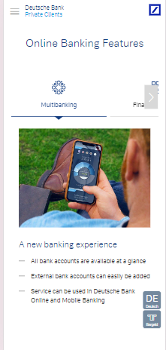
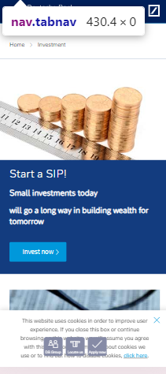
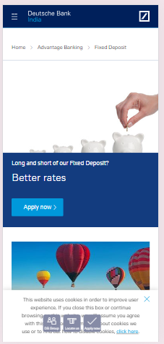
PHONE VIEW – 430*932

Slide 14
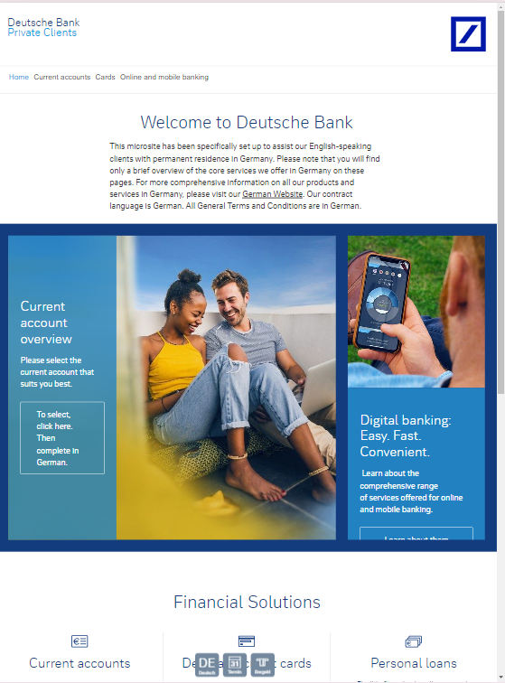
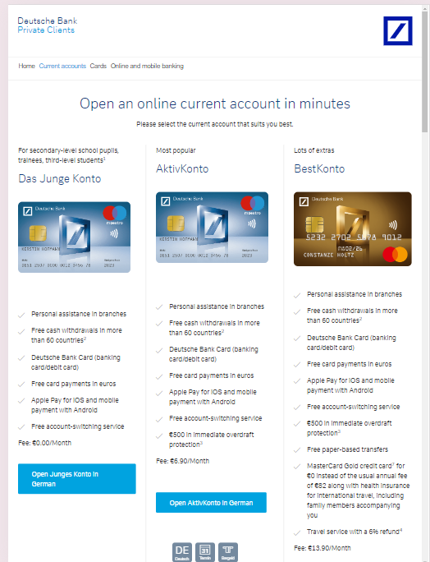
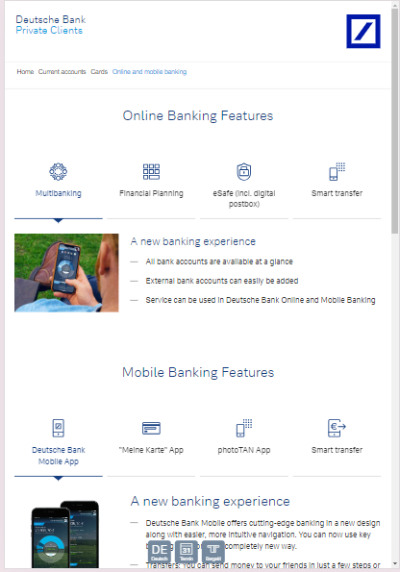
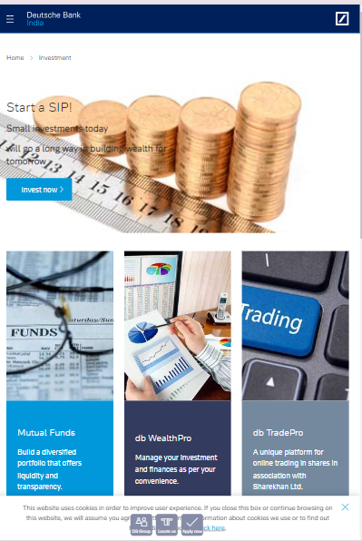
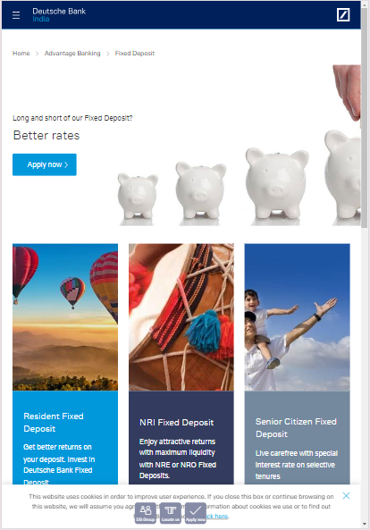
TABLET VIEW – 820*1180

Slide 15
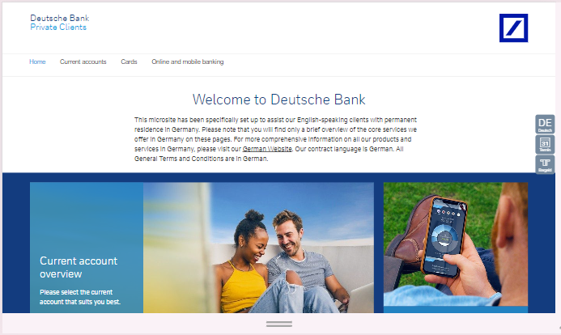
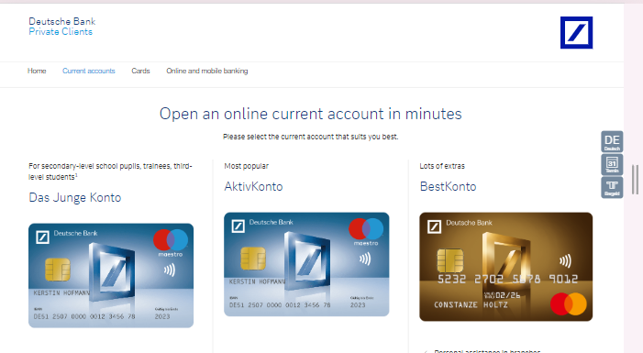
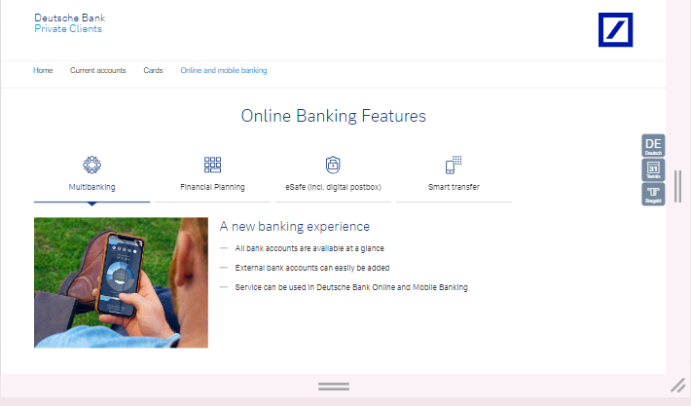
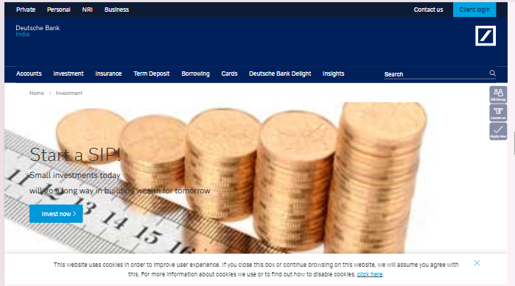
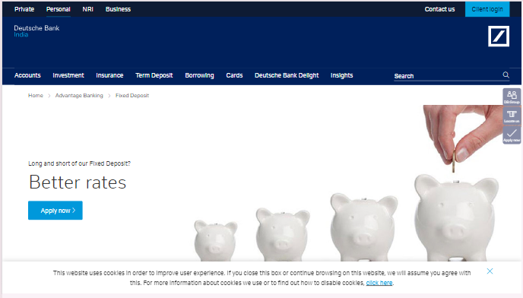
LAPTOP VIEW – 1366*768

Slide 16
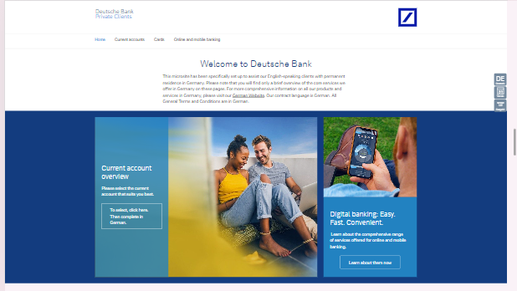
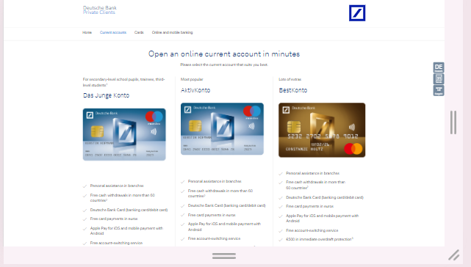
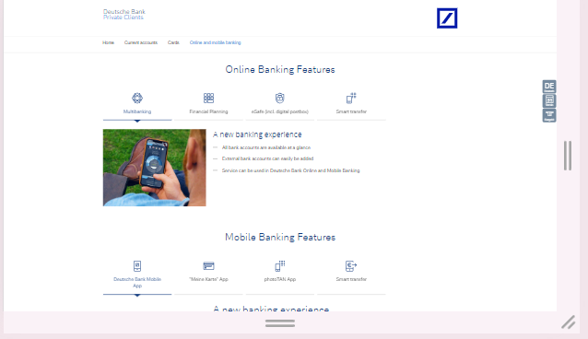
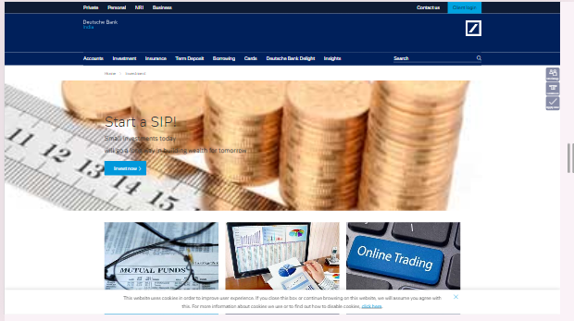
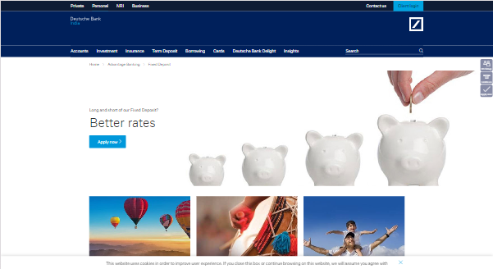
DESKTOP VIEW – 1920*1080

Slide 17
Website design mistakes to be avoided
Overloaded content
Poor content hierarchy
Lack of clear calls to action not being mobile-friendly
Slow loading speed
Lack in use of white space effectively

Slide 18
Overloaded content: Having too many images on a page can be overwhelming for visitors lacking text content Poor content hierarchy: Your most important information should be easy to find and understand. Use headings, subheadings, and bullet points to break up your content and make it scannable.

Slide 19
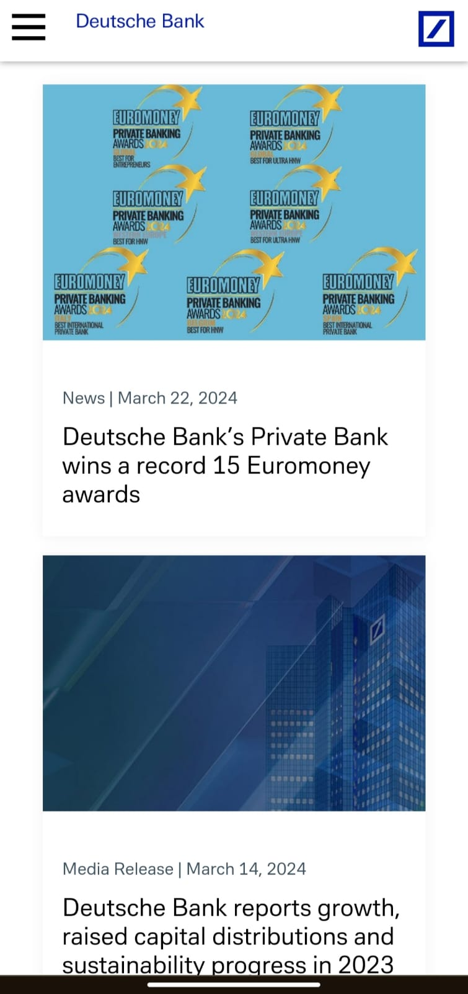
Lack of clear calls to action (CTAs): CTAs are buttons or phrases that tell visitors what you want them to do next, such as "Buy Now" or "Learn More." If your CTAs are weak or unclear, visitors won't know what to do which is not being mobile friendly.

Slide 20
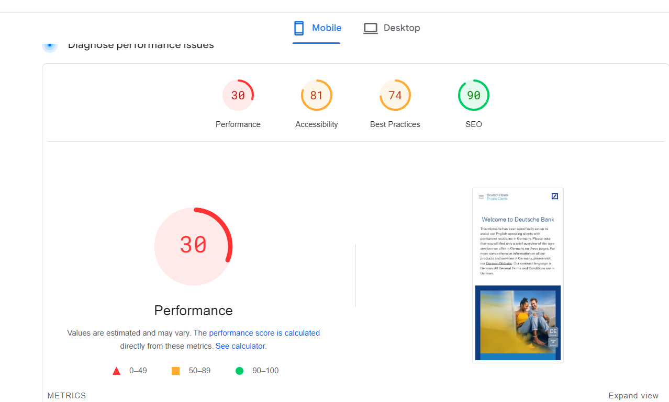
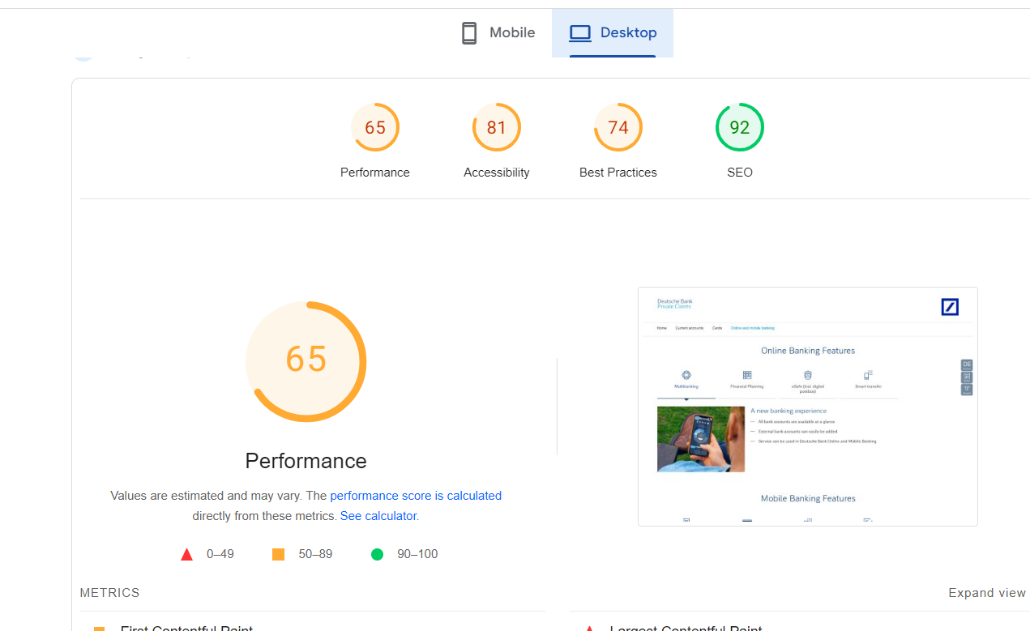
Slow loading speed

Slide 21
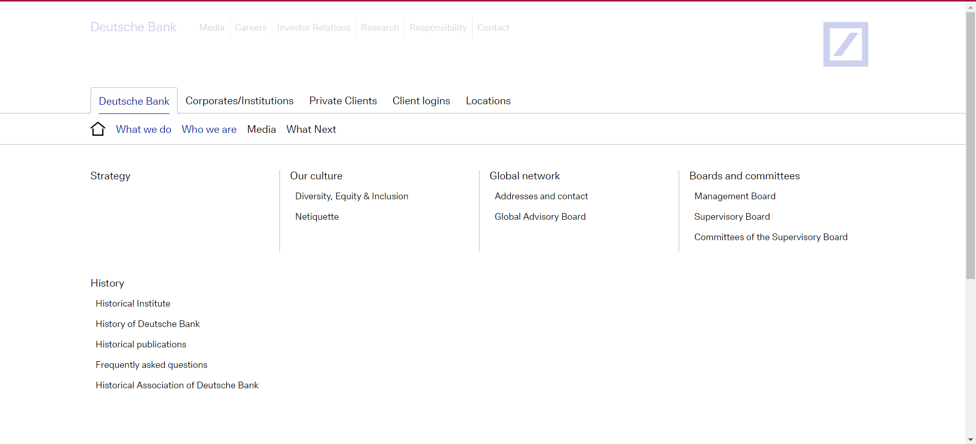
Lack in use of white space effectively

Slide 22
Creating visually appealing and user-friendly website design
Mobile-First Design: Ensure the website is responsive and adapts seamlessly to all screen sizes, especially smartphones and tablets.
Search Functionality: Provide a prominent and user-friendly search bar to help users find specific information.
Clear Calls to Action (CTAs): Use strong and action-oriented buttons and text to guide users towards desired actions like logging in, applying for services, or contacting customer support.
Accessibility: Follow web accessibility guidelines (WCAG) to make the website usable for people with disabilities. This includes features like alt text for images, proper keyboard navigation, and color contrast considerations.

Slide 23
Clear and Concise Content: Prioritize clear and concise language that is easy for the target audience to understand. Avoid financial jargon and use plain language whenever possible.
Content Hierarchy: Structure content with clear headings, subheadings, and bullet points to improve readability and information flow. Prioritize the most important information at the top of the page.
Targeted Content: Personalize the content based on user location or needs.
Multiple Content Formats: Offer a mix of content formats like text, images, videos, and infographics to cater to different user preferences.

Slide 24
LANDING PAGE
https://creditcardprojectwebsite.my.canva.site/creditcrad

Slide 25
THANK YOU

